Slide 1

PANIMALAR ENGINEERING COLLEGE
AN AUTONOMOUS INSTITUTION
DEPARTMENT OF INFORMATION TECHNOLOGY
PREDICTION THE DRUG RATING BASED ON REVIEWS BY USING
NATURAL LANGUAGE PROCESSING
Team Members
211420205161 Surya MM
211420205160 Suriya PM
211420205176 Venkat M
Guide Mrs.S.Uma

Slide 2
ABSTRACT :
Natural Language Processing (NLP) has gained significant attention in recent years due to its ability to analyse and understand human language. This paper presents a method for rating drugs based on reviews using NLP techniques. The objective is to develop a system that can automatically process and analyse drug reviews, extract relevant information, and generate ratings based on the sentiments expressed by the users. The proposed approach involves several stages.
First, a dataset of drug reviews is collected from various sources, such as online forums, social media platforms, and healthcare websites. The reviews are pre-processed to remove noise, perform tokenization, and handle any language-specific challenges. Next, sentiment analysis techniques are applied to determine the polarity of each review.
This involves classifying the sentiment expressed in the text as positive, negative, or neutral. Various algorithms, such as Naive Bayes, Support Vector Machines (SVM), or Recurrent Neural Networks (RNN), can be employed for this purpose.

Slide 3
LITERATURE REVIEW:
Title : Sentiment Analysis in Drug Reviews using Supervised Machine Learning Algorithms
Author: Sairamvinay Vijayaraghavan Debraj Basu
Year : 2020
Sentiment Analysis is an important algorithm in Natural Language Processing which is used to detect sentiment within some text. In our project, we had chosen to work on analyzing reviews of various drugs which have been reviewed in form of texts and have also been given a rating on a scale from 1-10. We had obtained this data set from UCI machine learning repository which had 2 data sets: train and test (split as 75-25%). We had split the number rating for the drug into three classes in general: positive (7-10), negative (1-4) or neutral(4-7). There are multiple reviews for the drugs which belong to the similar condition and we decided to investigate how the reviews for different conditions use different words impact the ratings of the drugs. Our intention was mainly to implement supervised machine learning classification algorithms which predicts the class of the rating using the textual review. We had primarily implemented different embeddings such as Term Frequency Inverse Document Frequency (TFIDF) and the Count Vectors (CV). We had trained models on the most popular conditions such as ”Birth Control”, ”Depression” and ”Pain” within the data set and obtained good results while predicting on the test data sets.

Slide 4
LITERATURE REVIEW:
Title : Developing A Deep Learning Natural Language Processing Algorithm For Automated Reporting Of Adverse Drug Reactions
Author: Christopher McMaster, Julia Chan, David FL Liew, Elizabeth Su1 , Albert G Frauman, Wendy W Chapman , Douglas EVPires
Year : 2021
The detection of adverse drug reactions (ADRs) is critical to our understanding of the safety and risk-benefit profile of medications. With an incidence that has not changed over the last 30 years, ADRs are a significant source of patient morbidity, responsible for 5-10% of acute care hospital admissions worldwide. Spontaneous reporting of ADRs has long been the standard method of reporting, however this approach is known to have high rates of under-reporting, a problem that limits pharmacovigilance efforts. Automated ADR reporting presents an alternative pathway to increase reporting rates, although this may be limited by over-reporting of other drug-related adverse events. We developed a deep learning natural language processing algorithm to identify ADRs in discharge summaries at a single academic hospital centre. Our model was developed in two stages: first, a pre-trained model (DeBERTa) was further pre-trained on 150,000 unlabelled discharge summaries; secondly, this model was fine-tuned to detect ADR mentions in a corpus of 861 annotated discharge summaries. To ensure that our algorithm could differentiate ADRs from other drug-related adverse events, the annotated corpus was enriched for both validated ADR reports and confounding drug-related adverse events using. The final model demonstrated good performance with a ROC-AUC of 0.934 (95% CI 0.931 - 0.955) for the task of identifying discharge summaries containing ADR mentions

Slide 5
EXISTING SYSTEM:
Removing all function errors is critical for making successful mobile apps. Since app testing may miss some function errors given limited time and resource, the user reviews of mobile apps are very important to developers for learning the uncaught errors. Unfortunately, manually handling each review is time-consuming and even error-prone.
Existing studies on mobile apps’ reviews could not help developers effectively locate the problematic code according to the reviews, because the majority of such research focus on review classification, requirements engineering, sentiment analysis, and summarization.
They do not localize the function errors described in user reviews in apps’ code. Moreover, recent studies on mapping reviews to problematic source files look for the matching between the words in reviews and that in source code, bug reports, commit messages, and stack traces, thus may result in false positives and false negatives since they do not consider the semantic meaning and part of speech tag of each word.
In this paper, we propose a novel approach to localize function errors in mobile apps by exploiting the context information in user reviews and correlating the reviews and bytecode through their semantic meanings.

Slide 6
PROPOSED SYSTEM:
The proposed system for drug rating based on reviews using Natural Language Processing (NLP) builds upon the existing system and introduces several enhancements and improvements. Here are the key aspects of the proposed system.
Enhanced Data Collection: The proposed system expands the data collection process to include a wider range of sources, such as patient surveys, clinical trial data, and electronic health records. By incorporating diverse data sources, the system aims to capture a more comprehensive and representative set of drug reviews.
Advanced Pre-processing: The proposed system utilizes advanced pre-processing techniques to handle challenges specific to drug reviews, such as medical terminology, abbreviations, and misspellings. It may employ domain-specific dictionaries or ontologies to improve the accuracy of text pre-processing and ensure the meaningful representation of drug-related information.
Fine-grained Sentiment Analysis: The proposed system aims to go beyond simple positive/negative sentiment classification and incorporates fine-grained sentiment analysis. It considers the nuanced opinions expressed in reviews, such as the severity of side effects, effectiveness for specific conditions, or satisfaction with drug interactions. This enables a more nuanced and informative rating system.

Slide 7
Novelty:
Go beyond reviews: Explore social media data like forum discussions or patient tweets. This can capture a wider range of emotions and drug use cases compared to curated reviews.
Incorporate medical literature: Include summaries of clinical trials or patient reported outcomes to enrich the training data with factual information about efficacy and side effects.
Aspect-based sentiment analysis: Move beyond overall sentiment to identify specific aspects of the drug that users are praising or criticizing. This can provide more actionable insights.

Slide 8
ENVIRONMENT REQUIREMENTS:
1. Software Requirements:
Operating System : Windows
Tool : Anaconda with Jupyter Notebook
2. Hardware requirements:
Processor : Pentium IV/III
Hard disk : minimum 80 GB
RAM : minimum 8 GB

Slide 9
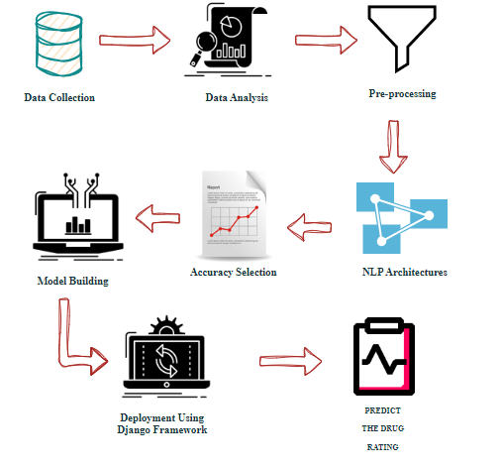
SYSTEM ARCHITECTURE DIAGRAM:

Slide 10
PREPARING THE DATASET:
Predicting drug ratings based on reviews using Natural Language Processing (NLP); preparing the dataset involves extracting and structuring text data from reviews for training a machine learning model.

Slide 11
LIST OF MODULES:
Data Pre-processing
Data Analysis of Visualization
Random Forest Algorithm
Decision Tree Algorithm
Gradient Boosting Algorithm
Deployment Using DJANGO

Slide 12
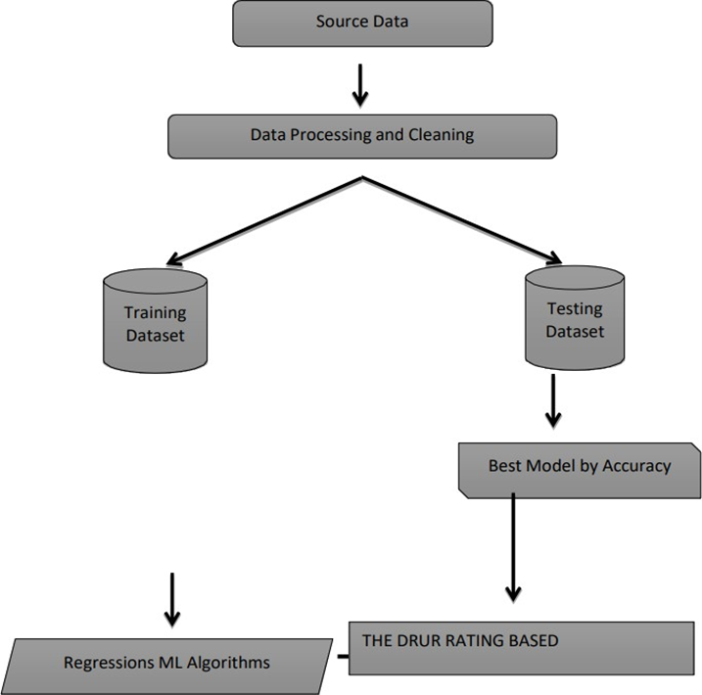
Work Flow :
Data Collection: The workflow begins with data collection. This step involves gathering relevant data from various sources, which may include databases, external datasets, APIs, Best Model by Accuracy, The Drug Rating Based Source Data, Data Processing and Cleaning Training Dataset Testing Dataset 35 or sensors. Data collection may also encompass the annotation of data, such as labelling images or categorizing text.
Data Pre-processing: After data collection, the raw data often needs to be cleaned and pre-processed. This step includes handling missing values, removing duplicates, and addressing outliers. Data pre-processing also involves data normalization, scaling, and feature engineering to make the data suitable for modelling.
Data Splitting: The dataset is typically divided into training, validation, and testing sets. This separation is crucial for training and evaluating the machine learning model effectively.

Slide 13
Model Testing: After successful validation, the models are tested on the separate testing dataset to assess their generalization ability and ensure they perform well on unseen data. Model Deployment: Once a satisfactory model is obtained, it can be deployed into a production environment where it can make predictions on new, real-world data.
Monitoring and Maintenance: Continuous monitoring of the deployed model is crucial to ensure that it performs as expected over time. This includes tracking data drift and model drift. Maintenance involves updating the model and retraining it as new data becomes available or as the model's performance degrades.
Model Building: In this step, machine learning models are designed, implemented, and trained using the pre-processed data. This may involve selecting a suitable algorithm, architecture, or framework. Hyper parameter tuning, cross-validation, and other techniques are applied to optimize the model's performance.
Model Evaluation: The trained models are evaluated using the validation dataset to assess their performance and make necessary improvements. Common evaluation metrics include accuracy, precision, recall, F1 score, and more, depending on the problem type (classification, regression, etc.).

Slide 14
Random Forest Algorithm:
Predicting drug ratings based on reviews using Natural Language Processing (NLP) and the Random Forest algorithm involves preprocessing textual data, extracting relevant features, and training a Random Forest model.
The algorithm analyzes the sentiments and patterns within reviews to predict the drug ratings accurately.
This approach leverages the power of ensemble learning and NLP techniques to create a robust model capable of handling the complexity of textual data, providing an effective solution for drug rating prediction.

Slide 15
Decision Tree Algorithm:
In this project, we aim to predict drug ratings based on reviews using Natural Language Processing (NLP) and the Decision Tree algorithm. We will preprocess and analyze textual reviews, extracting relevant features from the text.
Using the Decision Tree algorithm, we'll build a predictive model that learns patterns and relationships between the extracted features and drug ratings.
This approach leverages the inherent structure of decision trees to make predictions, offering interpretability in understanding how specific words or phrases influence drug ratings. By combining NLP and Decision Trees, we aim to create an effective and interpretable model for predicting drug ratings from textual reviews.

Slide 16
Gradient Boosting Algorithm:
Predicting drug ratings from reviews using Natural Language Processing (NLP) with a Gradient Boosting algorithm.
This approach leverages the power of NLP to analyze and extract insights from textual data, while the Gradient Boosting algorithm enhances predictive accuracy by combining multiple weak learners.
The model aims to correlate language patterns in reviews with corresponding drug ratings, enabling effective sentiment analysis for improved rating predictions.

Slide 17
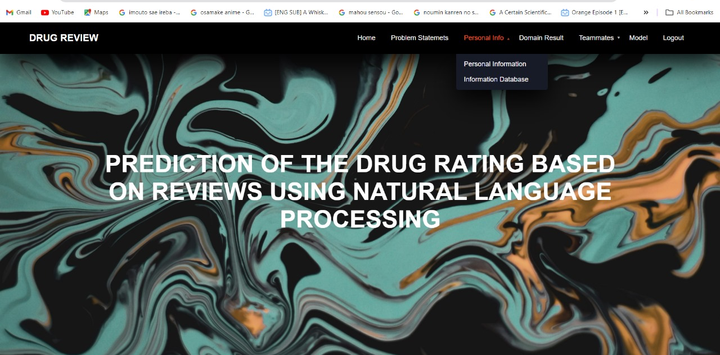
OUTPUT:

Slide 18
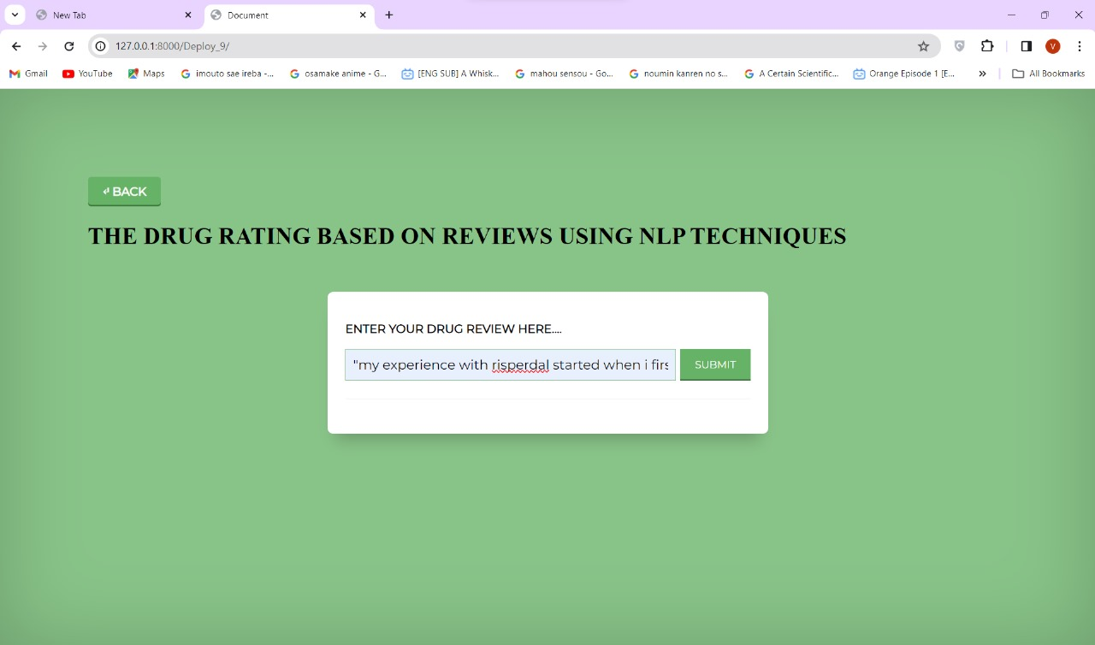
OUTPUT:

Slide 19
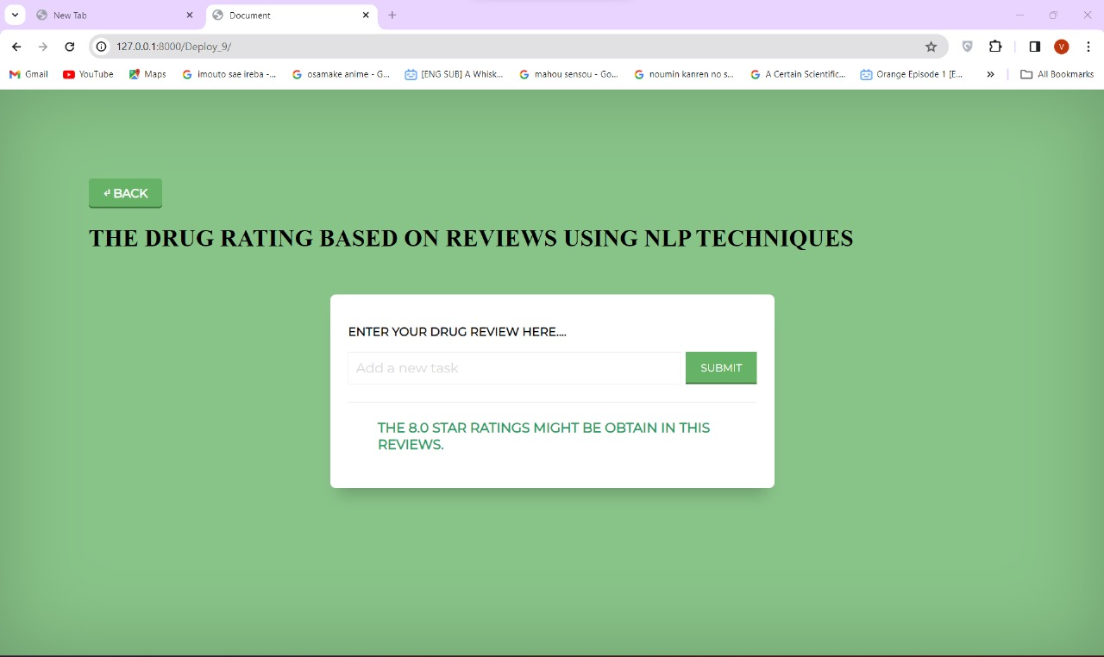
OUTPUT:

Slide 20
CONCLUSION:
In conclusion, leveraging Natural Language Processing (NLP) for drug rating prediction through reviews presents a transformative approach. By extracting key sentiments, themes, and contextual information from user feedback, this method offers a nuanced understanding of drug efficacy and user satisfaction. The application of advanced NLP techniques facilitates the creation of a robust model capable of accurately predicting drug ratings, thereby enhancing decision-making processes in healthcare and pharmaceutical domains. This innovative approach holds immense potential for revolutionizing how we assess and comprehend drug performance based on real-world user experiences.

Slide 21
FUTURE WORK:
Develop a predictive model using natural language processing features extracted from drug reviews. Utilize machine learning algorithms to analyze textual data and predict drug ratings, enabling a proactive approach to identify potential issues and enhance overall drug quality.
Implement a user-driven feedback mechanism to continuously improve the predictive model. Allow users to provide feedback on predicted ratings, leveraging NLP to understand and incorporate their insights. This iterative process ensures adaptability to evolving language patterns and enhances the accuracy of future predictions.

Slide 22
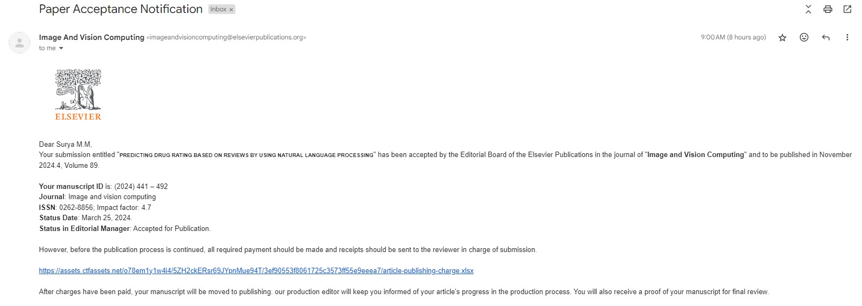
PUBLICATION DETAILS:

Slide 23
REFERENCES:
1. World Health Organization. 2020. Pharmacovigilance. [online] Available at:
https://www.who.int/teams/regulationprequalific ation/regulation-and-safety/pharmacovigilance
[Accessed 12 April 2022].
2. Pharmacology Education, 2022. [Online].Available:https://www.pharmacologyed
ucation.org/clinicalpharmacology/adverse-drug-r eaction. [Accessed: 31- Aug- 2022].
3. A. Kaplan and M. Haenlein, "Users of the world, unite! The challenges and opportunities of
Social Media", Business Horizons, vol. 53, no. 1, pp. 59-68, 2010. Available:
10.1016/j.bushor.2009.09.003.
4. R. Alt & M .Wittwer,. “Towards an ontology-based approach for social media analysis”, In
Proceedings of 22 European Conference on Information Systems (ECIS 2014), 2014.
5. PatientsLikeMe, 2022. [Online]. Available: https://www.patientslikeme.com/. [Accessed:
30- Aug- 2022].
6. Drugs.com,2022. [Online]. Available: https://www.drugs.com/. [Accessed: 30- Aug2022].
7. blog.23andme.com, 2022. [Online]. Available: https://blog.23andme.com/. [Accessed: 30-
Aug- 2022].

Slide 24
REFERENCES:
6. Drugs.com,2022. [Online]. Available: https://www.drugs.com/. [Accessed: 30- Aug2022].
7. blog.23andme.com, 2022. [Online]. Available: https://blog.23andme.com/. [Accessed: 30-
Aug- 2022].
8. M. Wiley, C. Jin, V. Hristidis and K. Esterling, "Pharmaceutical drugs chatter on Online
Social Networks", Journal of Biomedical Informatics, vol. 49, pp. 245-254, 2014. Available:
10.1016/j.jbi.2014.03.006.
9. Z.Min,” Drugs Reviews Sentiment Analysis using Weakly Supervised Model”. In 2019 IEEE
International Conference on Artificial Intelligence and Computer Applications (ICAICA),pp. 332-
336, 2019.
10. F.Gräßer, S.Kallumadi, H.Malberg, & S.Zaunseder,” Aspect-based sentiment analysis of
drug reviews applying cross-domain and crossdata learning”. In Proceedings of the 2018
International Conference on Digital Health , pp. 121-125, 2018.
11. UCI Machine Learning Drug Review dataset. Kaggle.com, from
https://www.kaggle.com/jessicali9530/kuc-hacka thon-winter-2018. [Accessed 12 April 2022].

